Slide 1

See the silence:
improving visual-only voice activity detection by
optical flow and RGB fusion
Danu Caus Guillaume Carbajal Timo Gerkmann Simone Frintrop
This work was supported by the Alliance of Hamburg Universities for Computer Science (ahoi.digital) as part of the Adaptive Crossmodal Sensor Data Acquisition (ACSDA) research project and by the German Research Foundation (DFG) in the Transregional project Crossmodal Learning (TRR 169).

Slide 2
Motivation
Voice Activity Detection (VAD) is the task of identifying the presence or absence of human speech segments.
Speech Enhancement
VAD
Noise cancelation
Excellent when noise is small
Visual VAD
Robust to noise
Audio VAD
[Leglaive et al. ICASSP 2015]
[Guy et al. ICPR 2020]
Audio-Visual
VAD
[Ariav et al. 2019]
Most VAD systems are focused on audio.
Very few visual systems based on deep learning.
Current trend is to create audio-visual VAD systems and these will benefit from a robust visual-only branch.
Visual Voice Activity Detection
Caus Danu

Slide 3
Visual VAD State of the Art
Some methods use optical flow [Tao et al. INTERSPEECH 2015]
Some methods use landmarks extracted from RGB [Guy et al. ICPR 2020]
Visual branches of audio-visual systems make use of RGB mouth ROIs [Ariav et al. 2019]
Most work is on manual feature engineering, without deep-learning.
This approach: Visual-only with deep-learned, ensemble models (RGB and Optical flow).
Visual Voice Activity Detection
Caus Danu

Slide 4
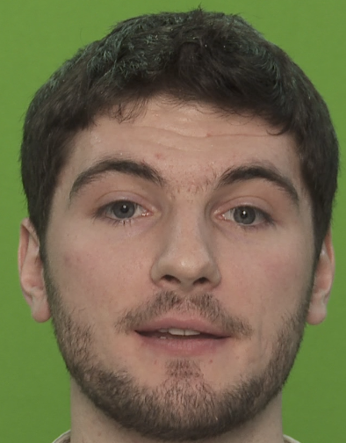
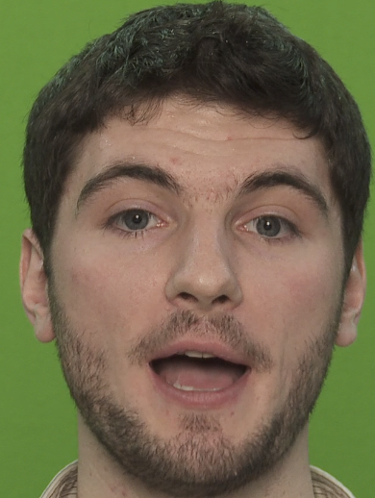

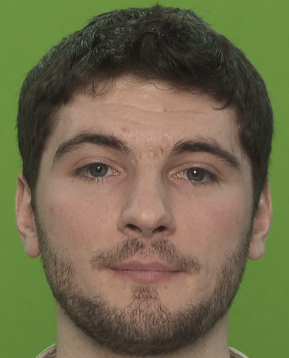
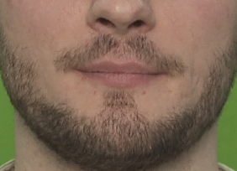
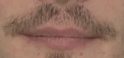
Contributions
Improve the true negative rate (TNR) for visual VAD systems by as much as 7%
Focusing on the lower face area (nose, mouth and chin) offers best results, as well as facilitates data handling. Other works consider full faces, or mouth-only regions of interest.
Visual Voice Activity Detection
Caus Danu

Slide 5
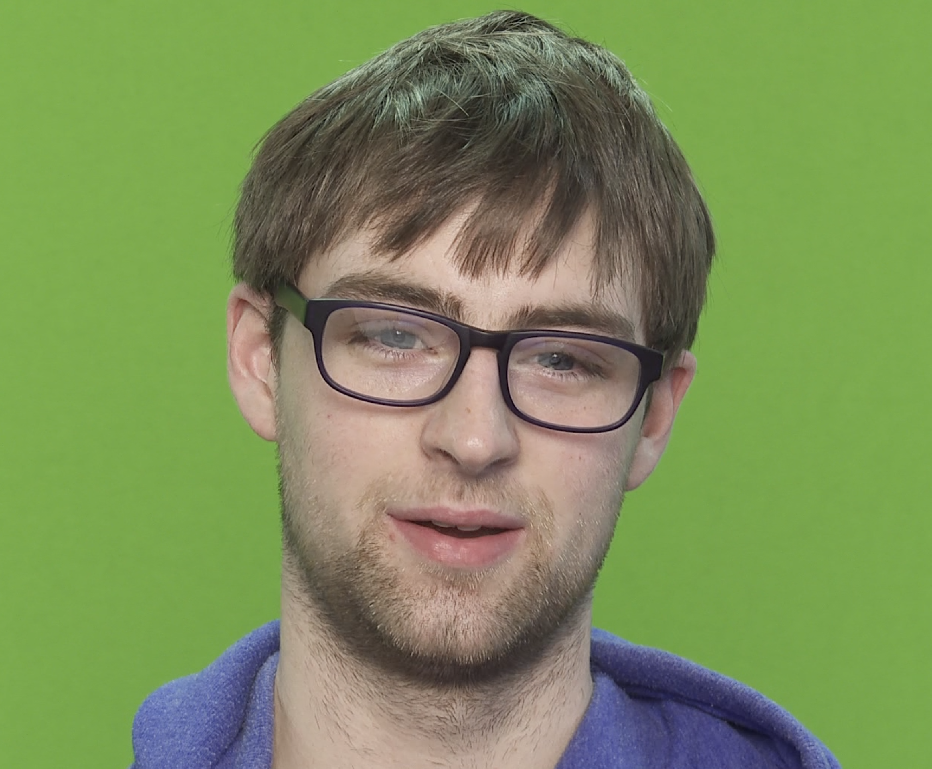

Cross-modal supervision
RGB stream
Fusion
Audio supervision
(audio ground truth inference)
Voice/
No voice
Optical flow stream
Visual Voice Activity Detection
Caus Danu

Slide 6
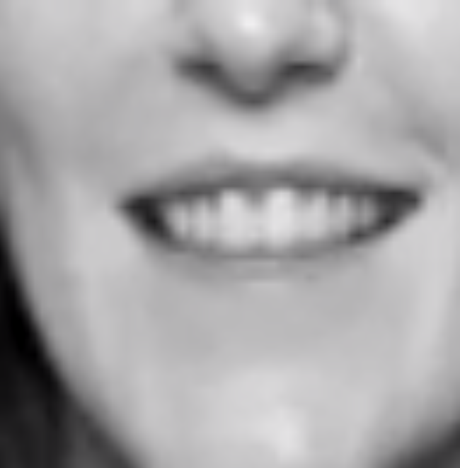
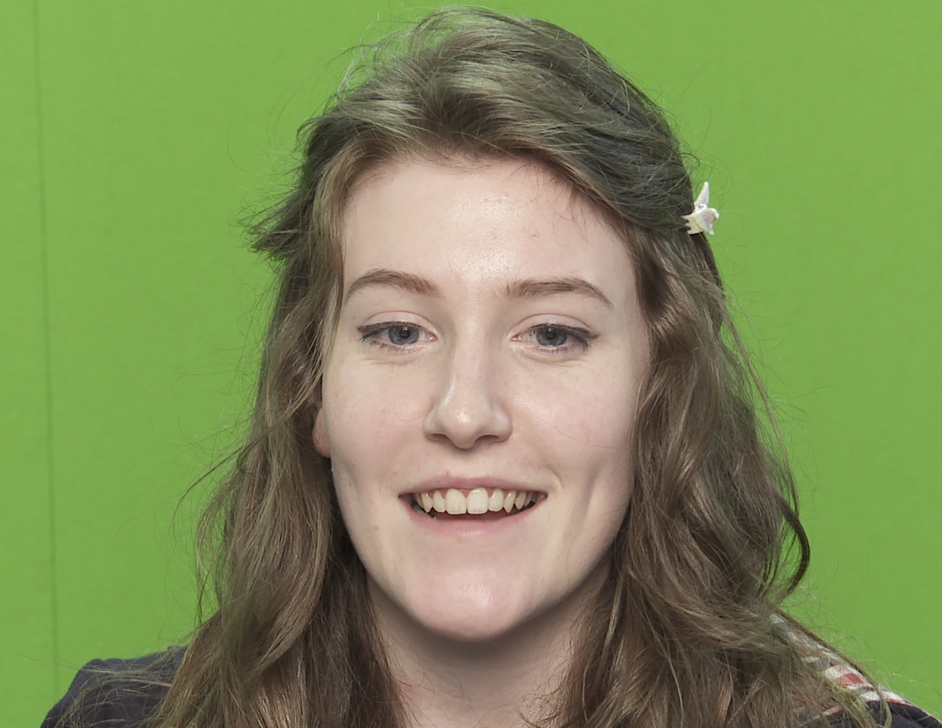
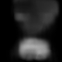
Overall System
Grayscale
RGB ResNet18
Stream
LSTM
P(Voice)
Fusion
Voice/
No voice
ROI Extractor
Optical flow
Optical Flow ResNet18
Stream
LSTM
P(Voice)
Pre-processing phase
Feature learning
phase
Time series analysis phase
Post-processing
phase
Visual Voice Activity Detection
Caus Danu

Slide 7
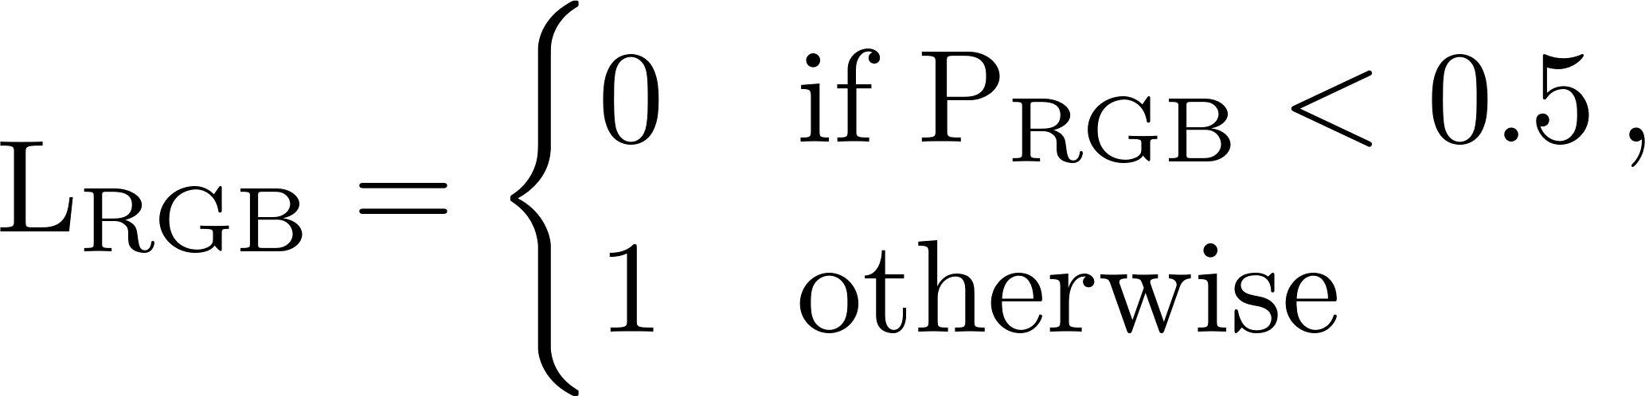
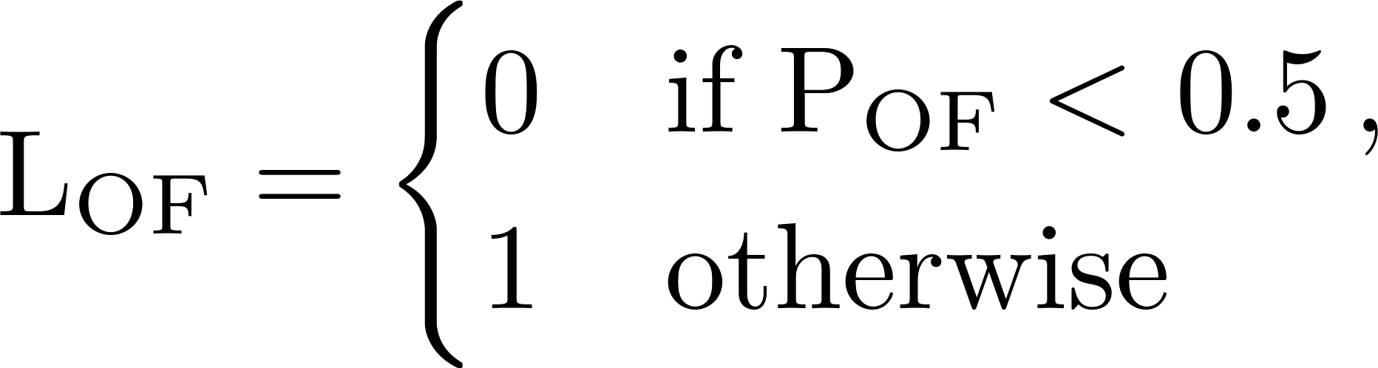
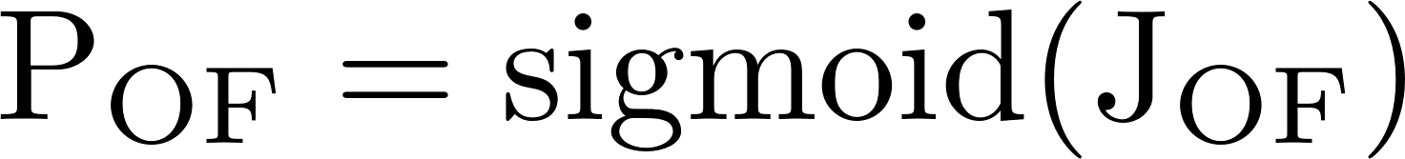
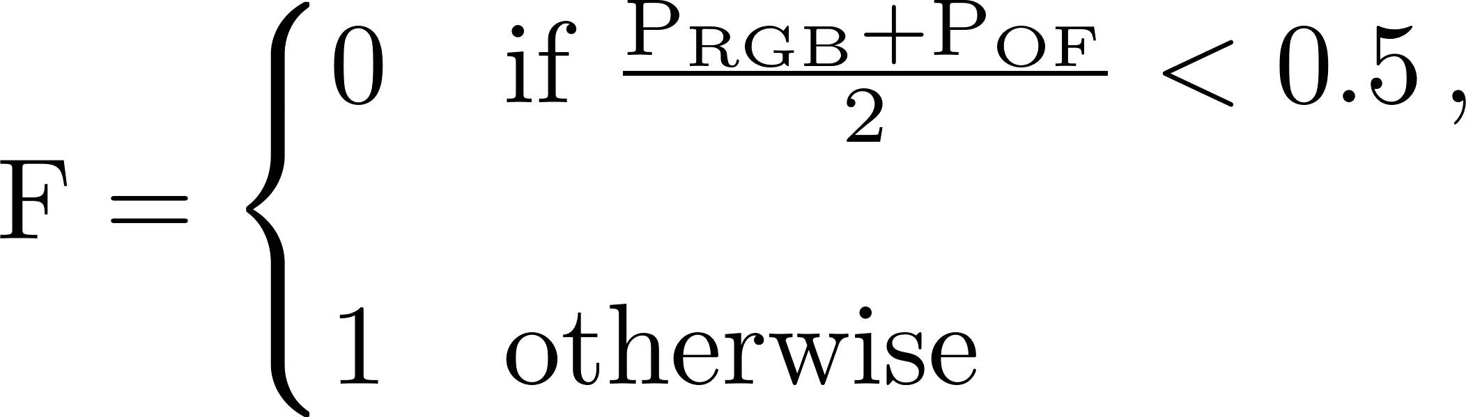
Training and Fusion
1) Train each branch individually
2) Fuse
This fusion offers a simple, yet effective explicit control over the probability threshold.
This is a useful to manually adjust in favour of one metric over another without retraining.
Visual Voice Activity Detection
Caus Danu

Slide 8
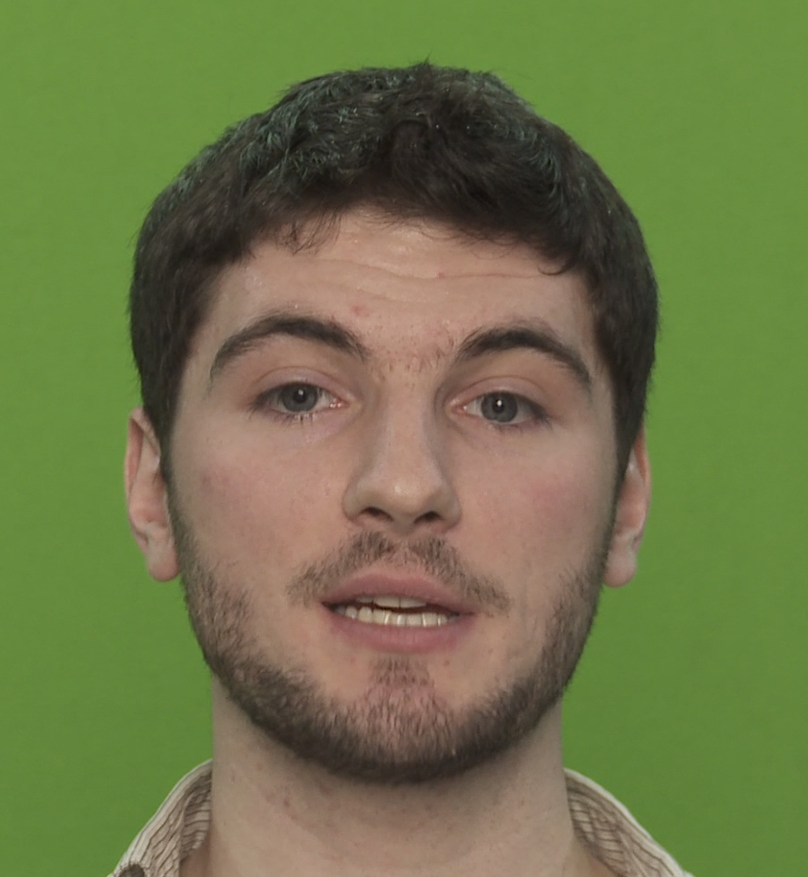
Dataset
We use TCD-TIMIT dataset (Harte et al. 2015)
Focuses on the faces of speakers rather than body language or body motion.
Already split into 42 train, 9 test and 8 validation speakers.
Each speaker utters 99 different sentences.
Visual Voice Activity Detection
Caus Danu

Slide 9




Architecture results
(Average TNR and TPR)
[Ariav et al. 2019]
Visual Voice Activity Detection
Caus Danu

Slide 10

Input type results
Visual Voice Activity Detection
Caus Danu

Slide 11

Contributions
Optical flow and RGB are complementary inputs for the VAD task.
Fusing both modalities results in a 7% TNR improvement.
Lower face regions offer better overall results across metrics and are easier to compute.
Open question: when is the optical flow branch more certain about voice presence then the RGB branch, and vice-versa.
Next: Fuse audio and video modalities.
Code available at:
https://github.com/rescer/VisualOnlyVoiceActivityDetection
Visual Voice Activity Detection
Caus Danu

Slide 12
References
[1] Leglaive, S., Hennequin, R., Badeau, R.: Singing voice detection with deep recurrent neural networks. In: 2015 IEEE International Conference on Acoustics, Speech and Signal Processing (ICASSP), pp. 121–125 (2015)
[2] Guy, S., Lathuiliere, S., Mesejo, P., Horaud, R.: Learning visual voice activity detection with an automatically annotated dataset. In: 2020 25th International Conference on Pattern Recognition (ICPR), pp. 4851–4856. IEEE (2021)
[3] Ariav, I., Cohen, I.: An end-to-end multimodal voice activity detection using wavenet encoder and residual networks. IEEE J. Sel. Topics Signal Process. 13(2), 265–274 (2019)
[4] Tao, F., Hansen, J.H., Busso, C.: An unsupervised visual-only voice activity detection approach using temporal orofacial features. In: Sixteenth Annual Conference of the International Speech Communication Association (2015)
[5] Harte, N., Gillen, E.: TCD-TIMIT: an audio-visual corpus of continuous speech. IEEE Trans. Multimedia 17(5), 603–615 (2015)
Visual Voice Activity Detection
Caus Danu

